Slide 1





HackOrbit 2025
CodeTrix

Slide 2


Submission Summary
Theme: Artificial Intelligence and Machine Learning
Idea Title | SmartRecruit AI: Automated CV-JD Matching with Interview scheduling
Team Name | CodeTrix
⚠️ Problem Statement | Enhancing Job Screening with AI and Data Intelligence: Recruiters face inefficiencies when manually scanning and shortlisting candidates due to an overwhelming volume of CVs, varied data formats, and subjective scoring methods and messy email chains for interview scheduling.
✨ Proposed Solution | We propose a smart, multi-agent recruitment assistant that automates the entire JD-to-candidate matching process. It extracts key details from JDs using AI, handles multiple-file format (PDF/DOCX/txt), and applies fine-tuned, match scoring for CVs using NLP, embeddings and cosine similarity. Built on a multi-agent framework with SQLite for long-term memory, the system offers real-time recruiter dashboard for analysis, threshold-based shortlisting, and automated Email and Interview scheduling.

Slide 3

PROPOSED SOLUTION
A Multi-agent, AI-powered system designed to streamline and enhance the entire hiring pipeline:
Features:
JD Understanding
Extracts core job requirements from multiple formats using AI and NLP — no manual reading needed.
Intelligent Resume Matching
Parses and scores CVs using Sentence embeddings, Cosine similarity, Fuzzy logic for deep, context-aware matching beyond keywords.
Smart Shortlisting
Applies a fine-tuned weighted scoring system (skills, experience, education, industry) with threshold-based filtering to rank candidates accurately.
Automated Communication & Scheduling
Generates personalized emails and auto-schedules interviews, removing the need for manual coordination.
Insights & Long-Term Memory
Provides real-time matching dashboards with past hiring status and uses SQLite-based memory for storing recruiter preferences and feedback loops (Recruiter can fine-tune scoring by adjusting weights for skills, education, and experience.).

Slide 4
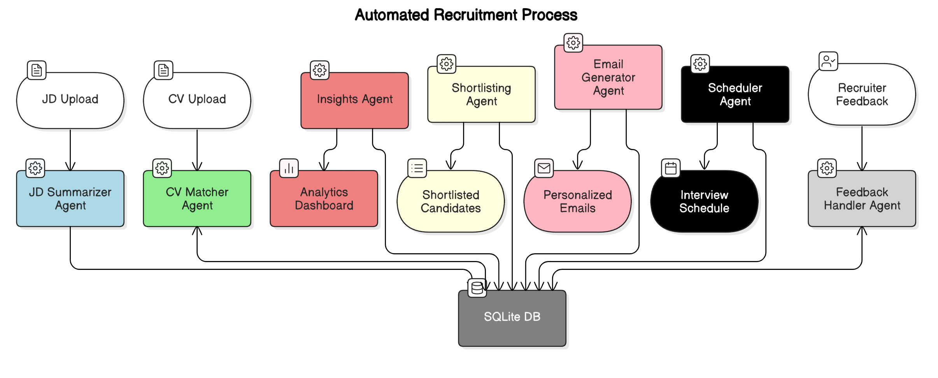
Agents’ Interaction Architecture
Interaction/System Flow

Slide 5
Technologies Used
List the key technologies, frameworks, and tools you utilized in your solution
AI/NLP Models
File, Text Handling & other tools:
Frontend
Backend
Python (FastAPI) – Async API framework powering JD & CV processing logic.
SQLite – Lightweight DB used for recruiter memory and scoring persistence.
Render – Backend deployment
SentenceTransformer (all-MiniLM-L6-v2) – Semantic embeddings
spaCy (en_core_web_sm) – NLP for normalisation and extraction
sklearn (Cosine Similarity), SequenceMatcher (Fuzzy Match), – Context-aware scoring
Gemini (API) + LLaMA 3.2B – JD summarization via LLM
React + Vite – Fast, modern UI framework.
Recharts – Interactive dashboards for CV-JD matching insights.
Vercel – Frontend hosting
PDFMiner, python-docx – Parse resumes from PDF/DOCX formats.
Regex, Logging, Requests – Utility tools for data parsing & API comms.

Slide 6
FEATURES AND NOVELTY
Novelty:
AI-driven CV–JD Matching using embeddings and cosine similarity
Support for Multiple CV Formats (PDF, DOCX, TXT) with unified parsing
Fine-tuned Match Scoring System — removes subjectivity in shortlisting
Threshold-based Auto Shortlisting to speed up screening
Built-in Interview Scheduling — eliminates messy email chains
Multi-Agent Framework — scalable, modular, and efficient
Features:
JD Understanding
Intelligent Resume Matching
Smart Shortlisting
Automated Communication & Scheduling
Insights & Long-Term Memory

Slide 7
Challenges:
Handling Resume Format Diversity
Context-Aware Matching Beyond Keywords
Dynamic JD Understanding
Efficient Real-Time Scoring & Dashboarding
Smart Shortlisting & Threshold Tuning

Slide 8
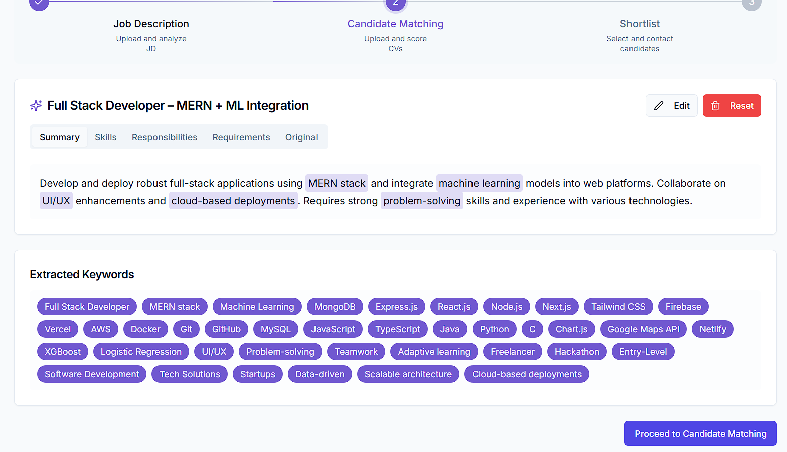
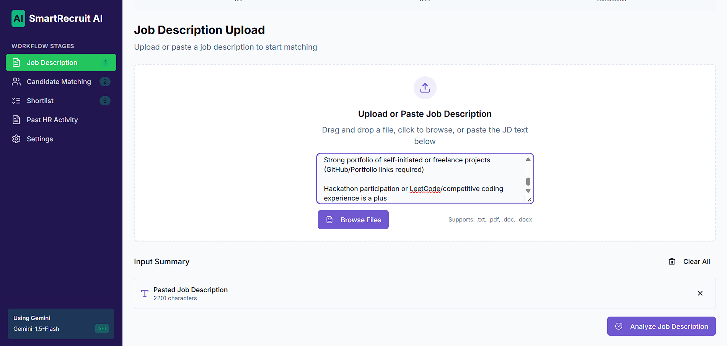
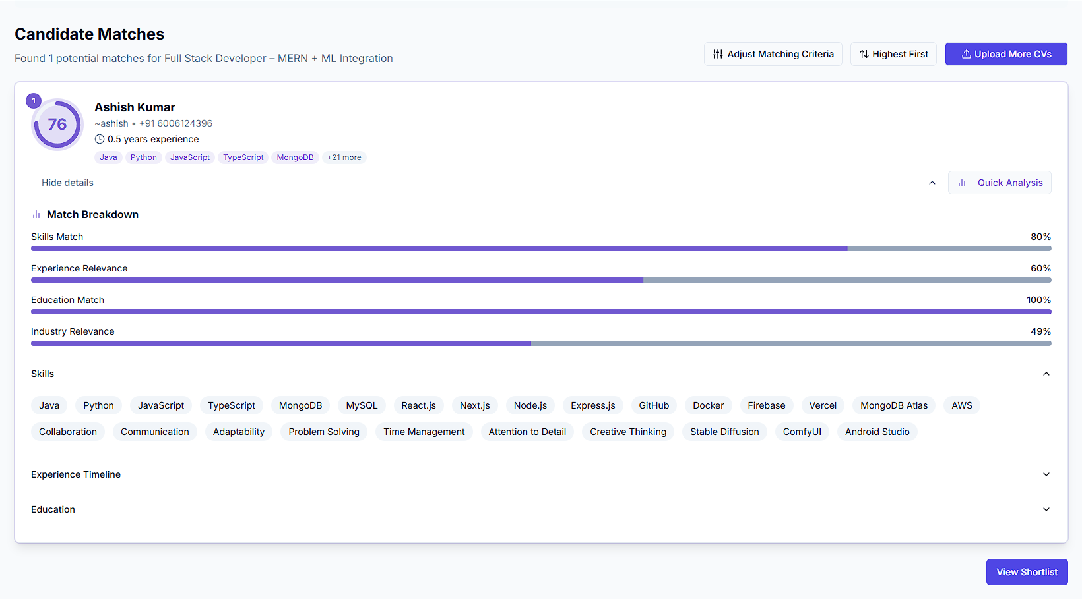
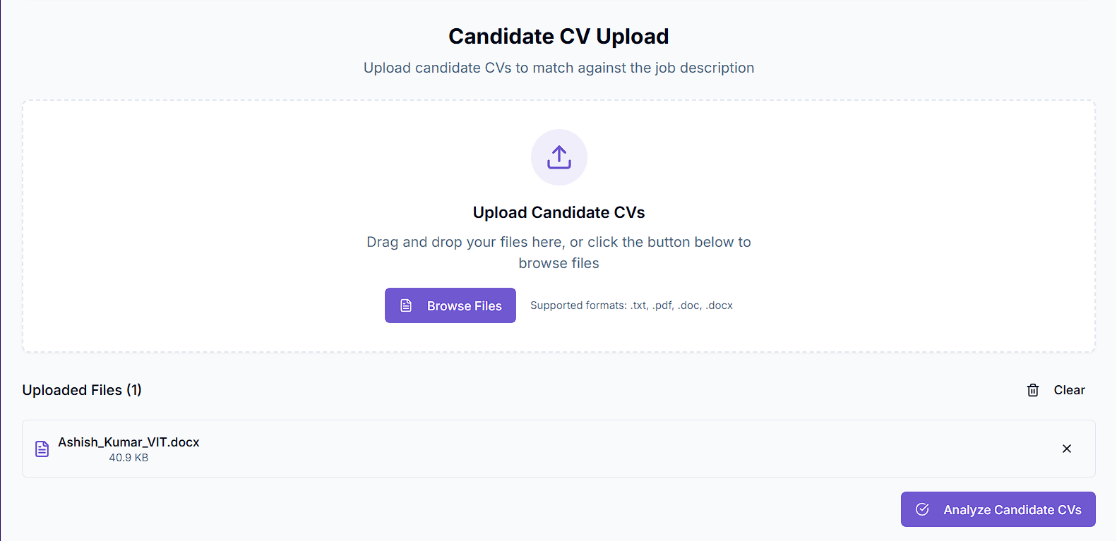
UI / UX Design (Ideation with Dummy data) :
2
1
3
4

Slide 9

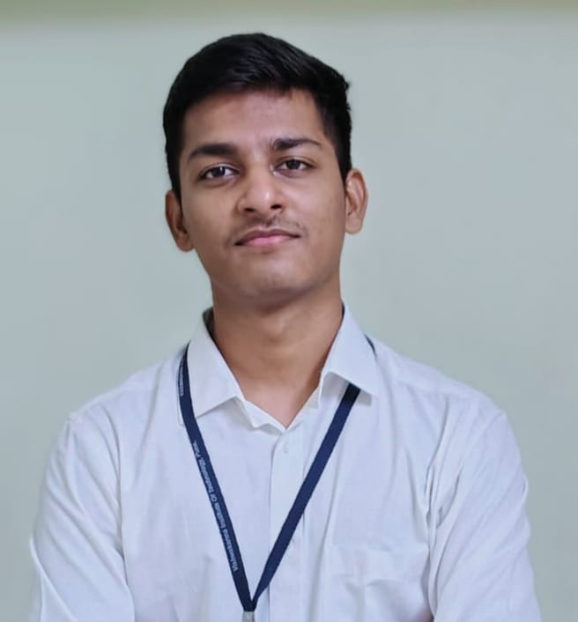
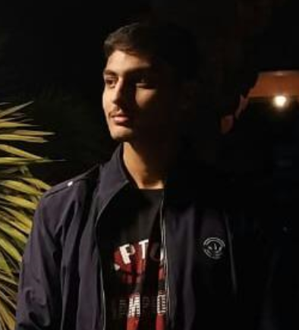
Team : CodeTrix
Team details:
Prathamesh Murkute (Team Leader) 8530442597 prathameshmurkute85@gmail.com
Photo
Suraj Baviskar 8446142512
surajbaviskar47@gmail.com
Ashish Kumar
6006124396
kumar.ashish23@vit.edu

Slide 10
Thank you

